Slide 1
COMPUTER
ARCHITECTURE
Lala Olusegun Gbenga, PhD

Slide 2
IFT 212
LECTURE 5

Slide 3
Instruction set design
Zero-address machines (stack machines)
How is it possible to have a machine without explicit operands instructions? This is possible if we know where the operands are, and where to store the results. In other words all operands are implicit.
A stack is a memory (sometimes called LIFO = Last In First Out) defined by two operations PUSH and POP: PUSH moves a new item from the memory into the stack (you don't have to care where), while POP gets the last item that was pushed into the stack. The formats of operations on a stack machine are:

Slide 4
Instruction set design
operation
PUSH op
POP op
where:
operation indicates the name of the operation to be performed. operation always acts on the value(s) at top of the stack
op is the address in the main memory where the value to be pushed/popped is located.
A stack machine has two memories: an unstructured one, we call it the main memory, where instructions and data are stored,

Slide 5
Instruction set design
and a structured one, the stack where access is allowed only through predefined operations (PUSH/POP). It is worth mentioning here that a stack has usually a very fast part where the top of the stack is located, and which is usually inside
CPU, while the large body of the stack is outside the CPU (possibly extensible to disk) and, hence, slower. One may envision the fast part of the stack (inside CPU) as the registers of the machine; as a matter of fact, a stack machine does not have explicit registers.

Slide 6
Instruction set design
Example: Statement Implementation:
Show how to implement the statement
a = a + b + a * c
using a stack machine.
Answer:
PUSH a # push the value of a;
PUSH c # push the value of c
MUL # multiply the two values on top of the stack
PUSH b
ADD
PUSH a
ADD
POP a # store the result back in memory at the address
where a is located.

Slide 7
Instruction set design
Whenever an operation is performed, the source operands are popped from the stack, the operation is performed, and the result is pushed into the stack.

Slide 8
Instruction set design
Example: STATEMENT IMLPEMENTATION:
Show the content of the stack while implementing the statement:
a = a + b + a * c
ANSWER:

Slide 9
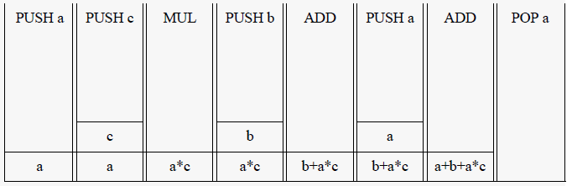
Instruction set design

Slide 10
Instruction set design
Example: Calculation of Clock Cycles:
Compute the number of clock cycles necessary to evaluate the statement:
a = a + b + a * c;
on an 8 bit stack machine, with 16 bit addresses. Assume that every memory access takes two clock cycles and that the execution phase of any instruction take only one clock cycle; assume also that addresses are absolute.

Slide 11
Instruction set design
Answer:
PUSH a # 2 + 2 * 2 + 2 clock cycles
PUSH c # 2 + 2 * 2 + 2
MUL # 2 + 1
PUSH b # 2 + 2 * 2 + 2
ADD # 2+ 1
PUSH a # 2 + 2 * 2 + 2
ADD # 2 + 1
POP a # 2 + 2 * 2 + 2
The above sequence of code completes in 49 clock cycles. Every PUSH or POP takes 2 clock cycles to read the opcode (one byte), plus 2 * 2 clock cycles to read the address (2 bytes) of the operand, plus 2 clock cycles to read/store the operand.

Slide 12
Instruction set design
It would be unfair to directly compare the performance of the stack machine in the above with the performance of machine in the previous
examples as long as the stack machine has to bring the operands from memory while in the other cases it was assumed that the operands are in registers.
The stack has the disadvantage that, by definition, it cannot be randomly accessed thus making it difficult to generate efficient code; note however that the easiest way to generate code in a compiler is from a stack machine.

Slide 13
Register or memory?
In classifying architectures we used the number of operands the most common arithmetic instructions specify. As we saw, the 3-address and 2-address machines may have operands in registers, memory or both.
A question may be naturally asked: which is the best way to design the instruction set? This is to say: should all instructions be register-register or may be should they all be memory-memory; what happens if we mix registers and memory in specifying operands?

Slide 14
Register or memory?
Example: Clock Cycles and Memory Traffic:
We have two 32 bit machines, a register-register and a memory-memory one. Addresses are 32 bit wide and the register-register machine has 32 general purpose registers. A memory access takes two clock cycles and an arithmetic operation executes in two clock cycles (the execution phase). Addresses of operands are absolute. Show how to implement the statement:
a = b * c + a * d;

Slide 15
Register or memory?
and compare the number of clock cycles, and the memory traffic for the two machines. Variables a, b, c, d reside in memory and no one may be destroyed but a. Assume also that instructions are 32 bit wide or multiples of 32 bit.
Answer:

Slide 16
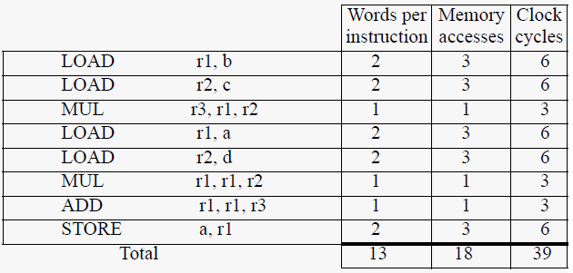
Register or memory?

Slide 17
Register or memory?
For the memory-memory machine:
For the memory-memory machine every instruction require 7 memory accesses: one to get the opcode, plus 3 to get the three addresses of the operands, plus other 3 to access the operands. The code for the memory memory machine is shorter than the code for the register-register machine, 12 words as compared with 13, but the memory traffic is higher, as well as the execution time.

Slide 18
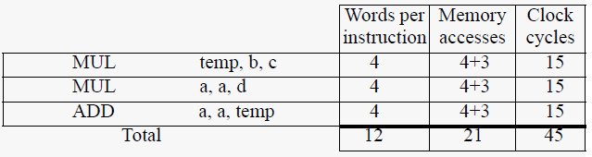
Register or memory?

Slide 19
Register or memory?
Even though in the above example we considered two different machines, it is quite common to have hardware that supports both models. This is the case with very successful machines like IBM-360 or DEC VAX; moreover these machines also support the register-memory model.

Slide 20
Register or memory?
The most valuable advantage of registers is their use in computing expression values and in storing variables. When variables are allocated to registers, the memory traffic is lower, the speed is higher because registers are faster than memory and code length decreases (since a register can be named with fewer bits than a memory location). If the number of registers is sufficient, then local variables will be loaded into registers when the program enters a new scope; the available registers will be used as temporaries, i.e. they will be used for expression evaluation.

Slide 21
Register or memory?
How many registers should a machine have? If their number is too small then the compiler will reserve all for expression evaluation and variables will be kept in memory thus decreasing the effectiveness of a register register machine. A too large number of registers, on the other hand, may mean wasted resources that could be used otherwise for other purposes.

Slide 22
Register or memory?
Most microprocessors from the first generation (8 bit like Intel 8080, or Motorola 6800) had 8 general purpose registers. A very successful 16 bit microprocessor, Intel 8086, had 14 registers though most of them were reserved for special purposes. Almost all 32 bit microprocessors on the market today have 32 integer registers, and many have special registers for floating point operations.
32 registers seem to be sufficient even for a 64 bit architecture; at least this is the point of view of the team who designed the ALPHA chip.

Slide 23
Register or memory?
Let's now summarize some of the basic concepts we have learnt so far so far. The basic criteria of differentiating architectures was the number of operands an instruction can have. Operands may be named explicitly or implicitly:
stack architectures: all operands are implicitly on the stack
accumulator architectures: one source operand and the destination are implicitly on the accumulator; the second source operand has to be explicitly named
general purpose register (GPR) architectures have only explicit operands, either registers or memory locations.

Slide 24
Register or memory?
GPR architectures dominate the market at this moment, basically for two reasons: first, registers are faster than memory and second, compilers use more efficient registers than other forms of temporary storage like accumulators or stacks. The main characteristics that divide GPRs are:
i. the number of operands a typical arithmetic operation has; we discussed about 2-address machines (one of the operands is both source and destination), and about three address-machines;
ii. number of operands that may be memory addresses in ALU operation. This number may vary from none to three.

Slide 25
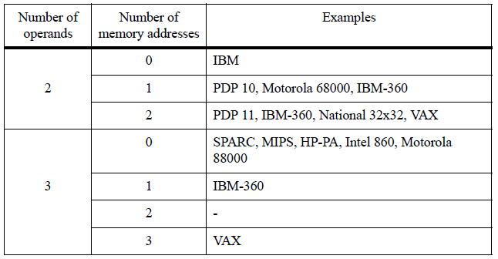
Register or memory?
Using the two parameters we have to differentiate GPR architectures, there are seven possible combinations in the table below:

Slide 26
Register or memory?
Please observe that IBM-360 appears in several positions in the table, due to the fact that the architecture supports multiple formats. The same is true for the VAX architecture.
Three combinations classify most of the existing machines:
i. register-register machines which are also called load-store. They are defined by 2-0 or 3-0 (operands-number of memory addresses); in other words all operands are located in registers
ii. register-memory machines: defined by 2-1 (operands-number of memory addresses); one of the operands may be a memory address;

Slide 27
Register or memory?
memory-memory machines: 2-2 or 3-3; all operands are memory addresses.
Here are some of the advantages and disadvantages of the above alternatives:
register-register machines
Advantages:
i. simple instruction encoding (fixed length)
ii. simple compiler code generation
iii. instruction may execute in the same number of clock cycles (for a carefully designed instruction set)
iv. lower memory traffic as compared with other architectures.

Slide 28
Register or memory?
Disadvantages:
i. higher instruction count than in architectures with memory operands
ii. the fixed format wastes space in the case of simple instructions that do not specify any register (NOP, RETURN etc.)
register-memory machines
Advantages:
i. more compact instructions than in register-register machines
ii. in many cases loads are spared (when an operand is in register and the other one is in memory)

Slide 29
Register or memory?
Disadvantages:
i. operands are not equivalent: in an arithmetic or logic operation one of the source operands is destroyed (this complicates the code generation in the compiler).
memory-memory machines
Advantages:
i. compact code
ii. easy code generation
Disadvantages:
i. different length instructions
ii. different running times for instructions
iii. high memory traffic.

Slide 30
Register or memory?
Disadvantages:
i. operands are not equivalent: in an arithmetic or logic operation one of the source operands is destroyed (this complicates the code generation in the compiler).
memory-memory machines
Advantages:
i. compact code
ii. easy code generation
Disadvantages:
i. different length instructions
ii. different running times for instructions
iii. high memory traffic.

Slide 31
References
Mostafa Abd-El-Barr and Hesham El-Rewini (2005), Fundamentals of Computer Organization and Architecture Published by John Wiley & Sons, Inc., Hoboken, New Jersey.
Virgil Bistriceanu, Computer Architecture, Illinois Institute of Technology

